Slide 1
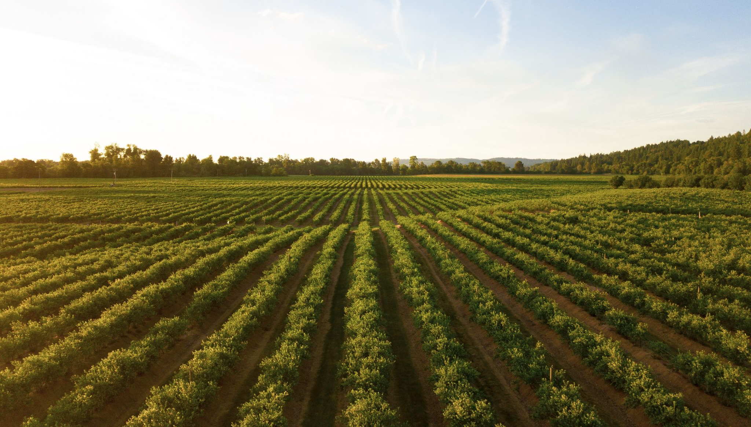

More Weeds

Slide 2
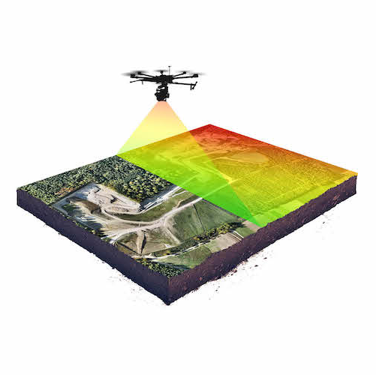
Application / Weeds Detection
Drone takes image of field
Detect weeds in images

Slide 3
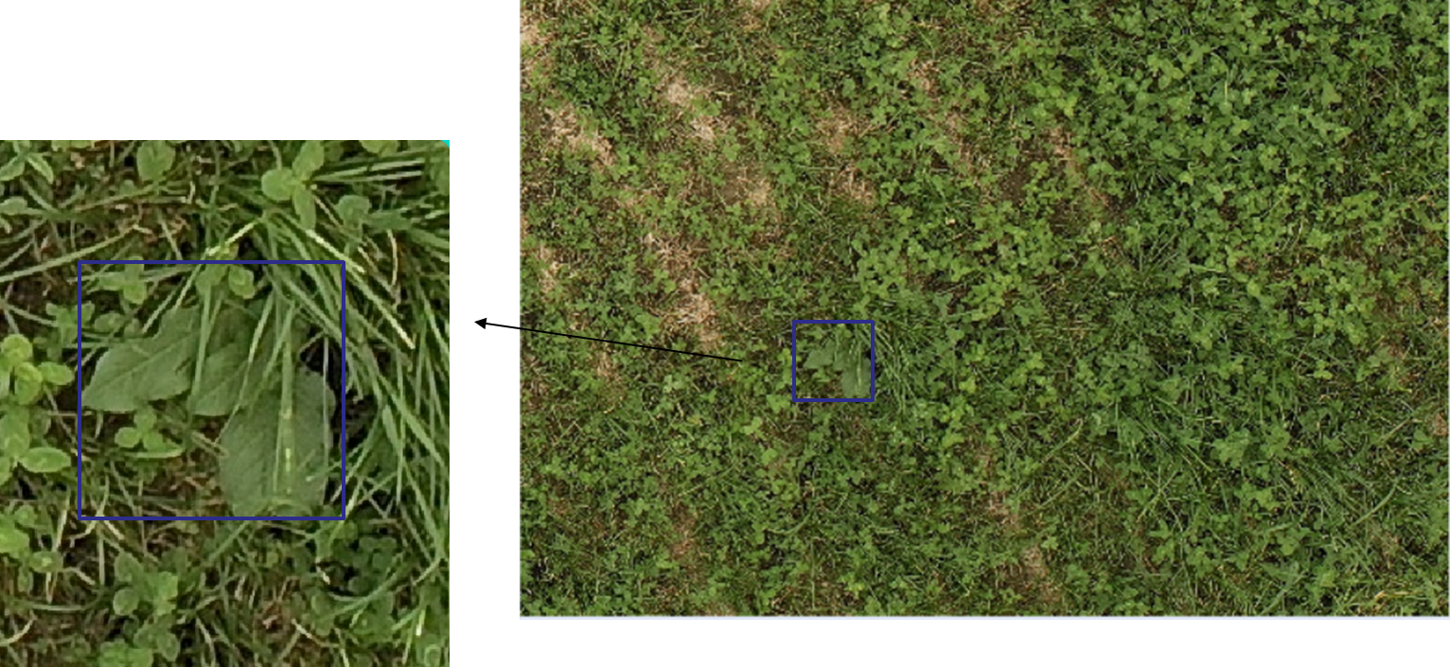
Image annotation is very expensive

Slide 4
Can GenAI help in generating images?
Generative Adversarial Networks.
Stable diffusion Inpaiting.

Slide 5
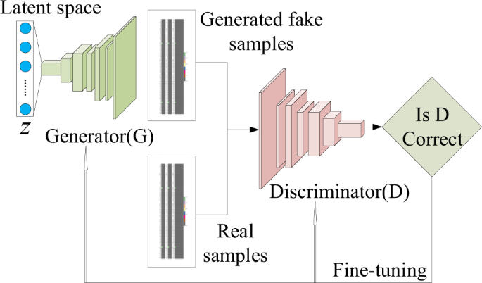
Generative Adversarial Network Model
We trained a model based on pre-annotated image patches.

Slide 6
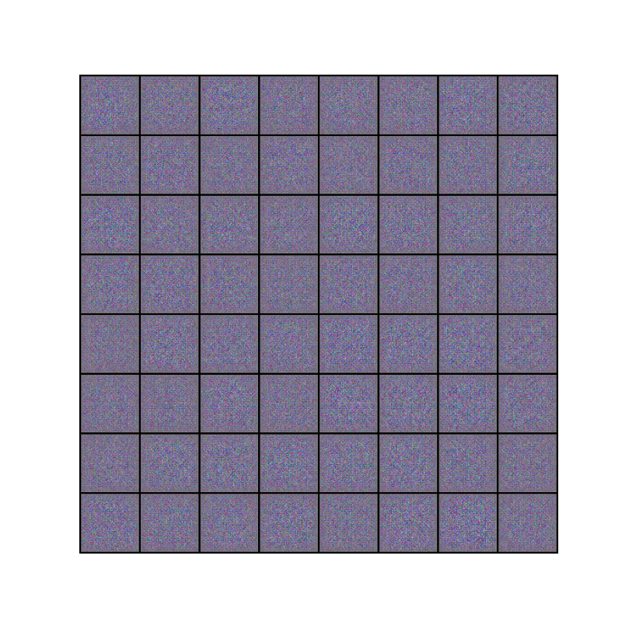

Slide 7
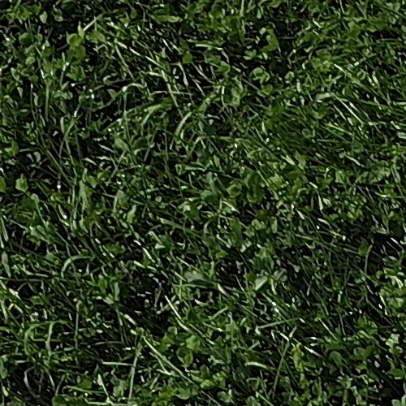
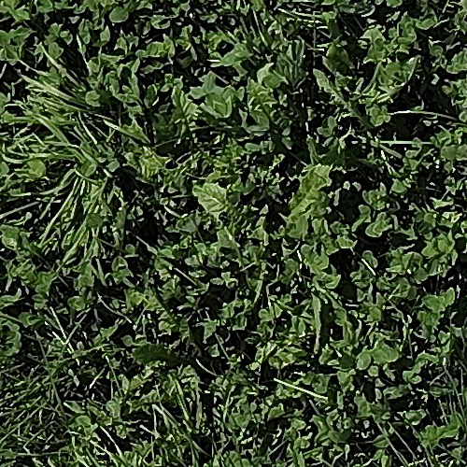
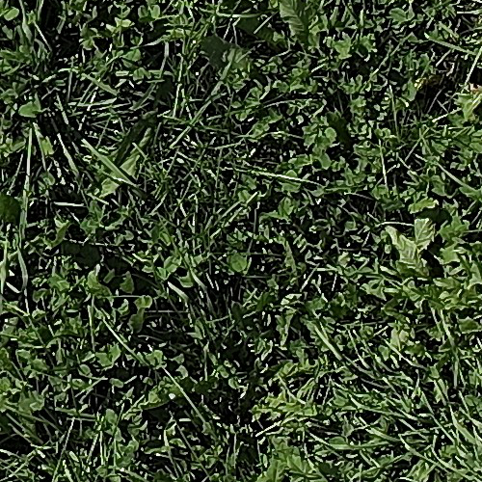
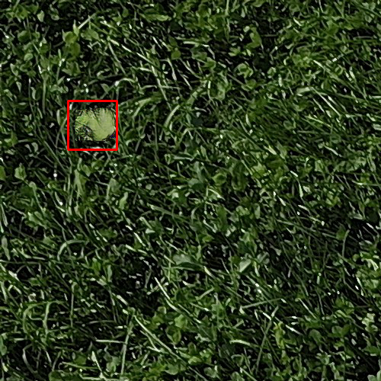
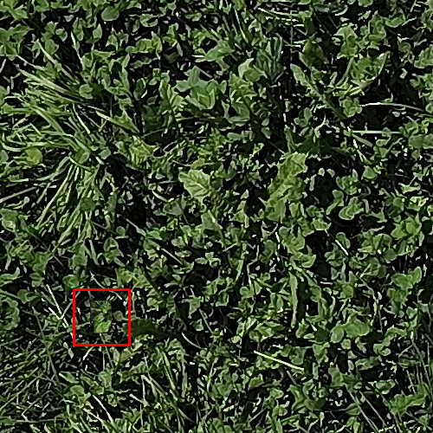
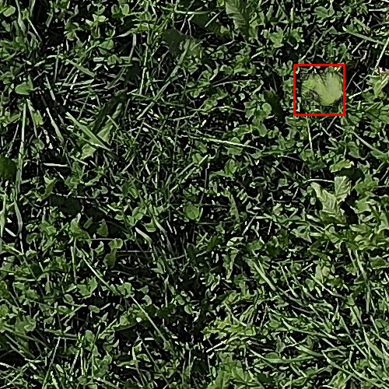
Add generated weeds on backgrounds

Slide 8

Methods for adding images on backgrounds
Simple overlay
Inpainting

Slide 9
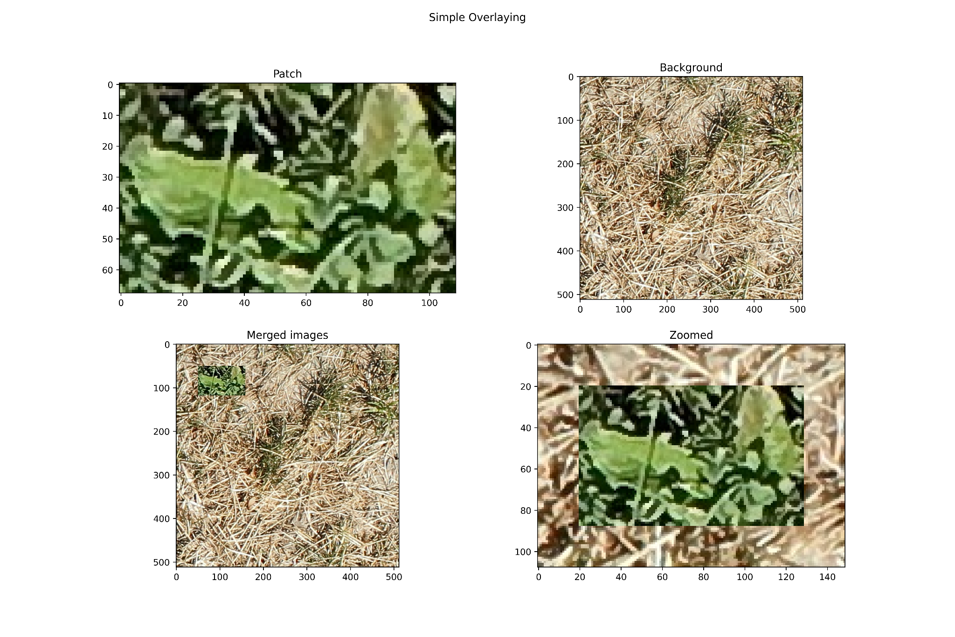
Simple overlay

Slide 10

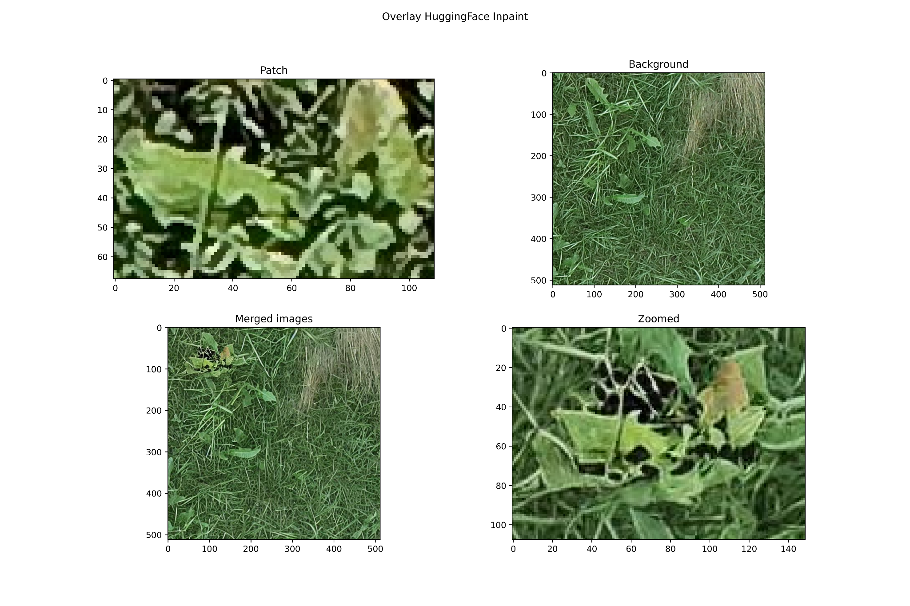
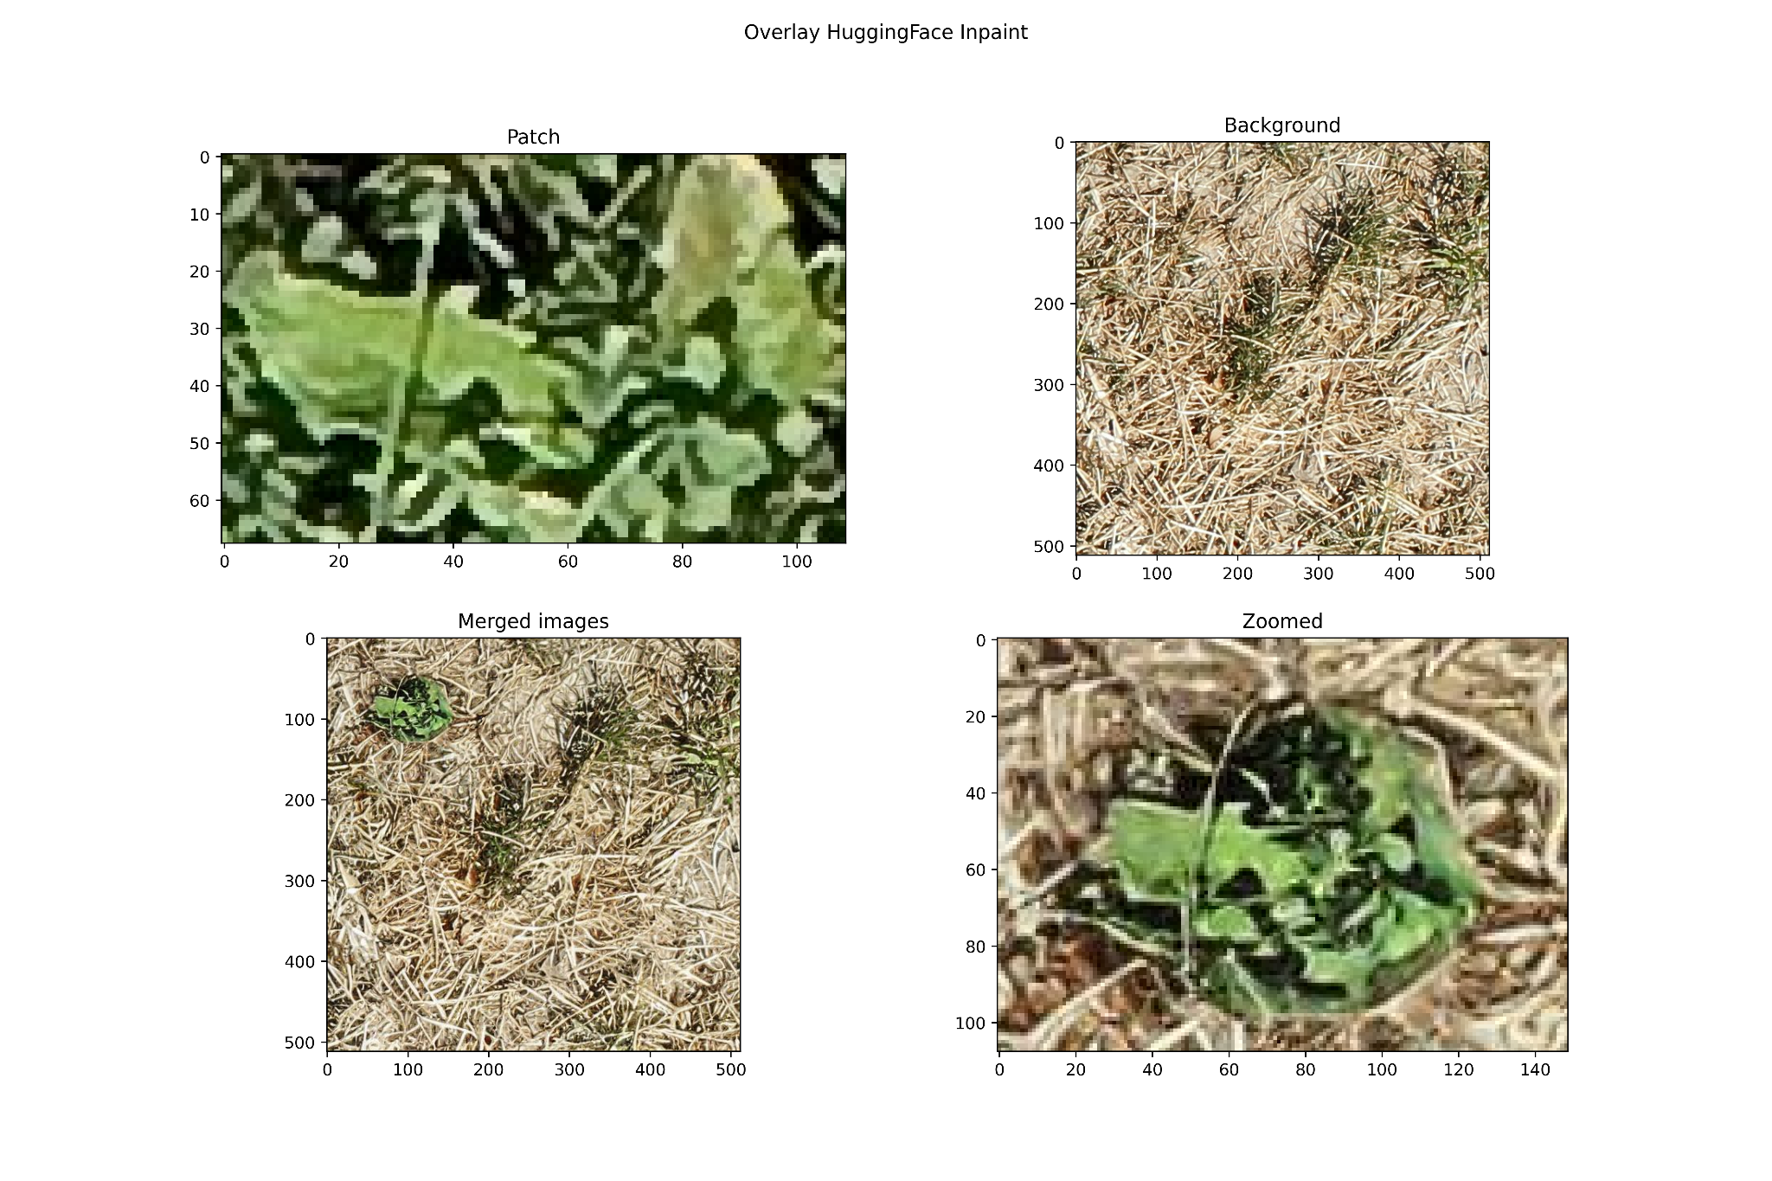
Inpainting

Slide 11
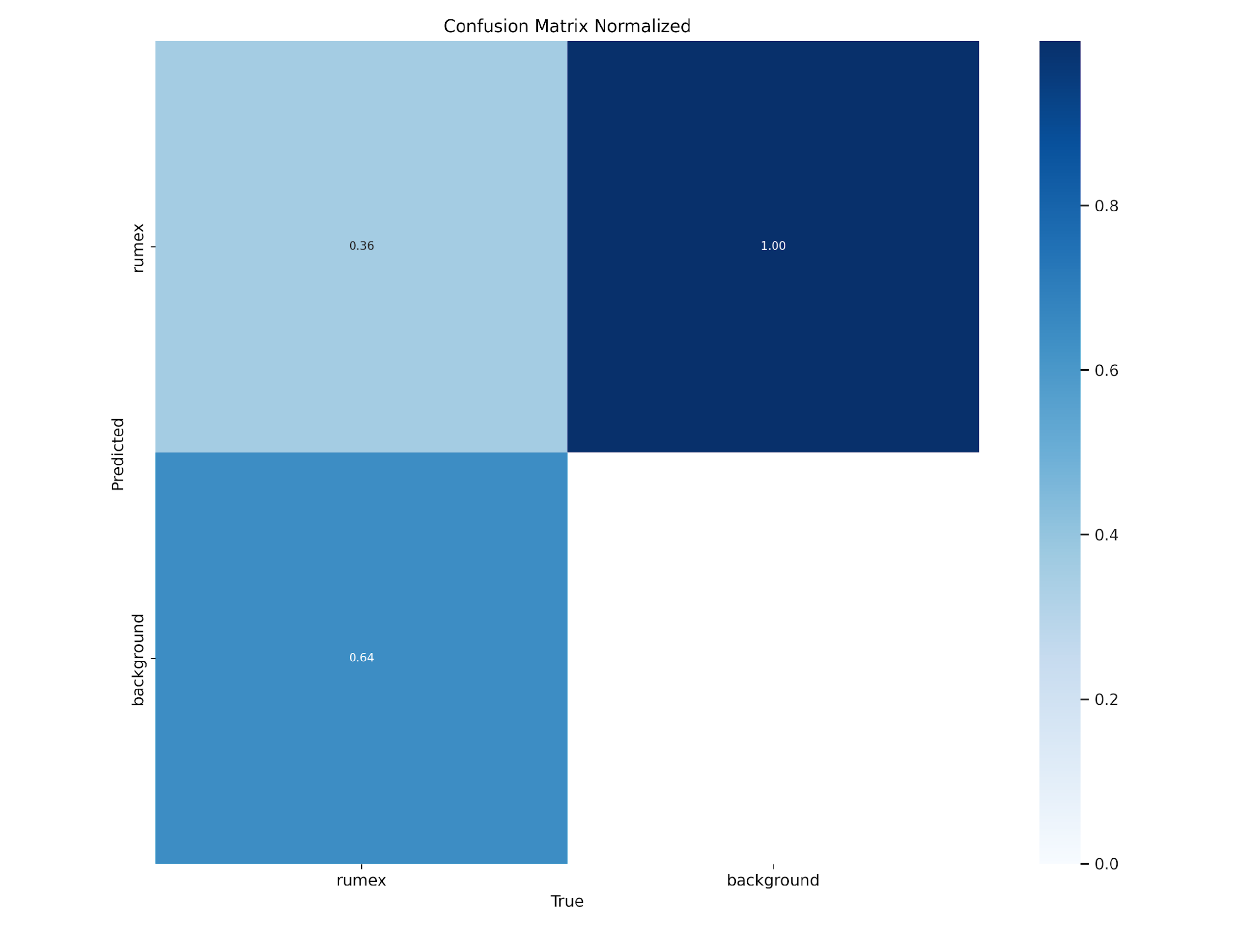
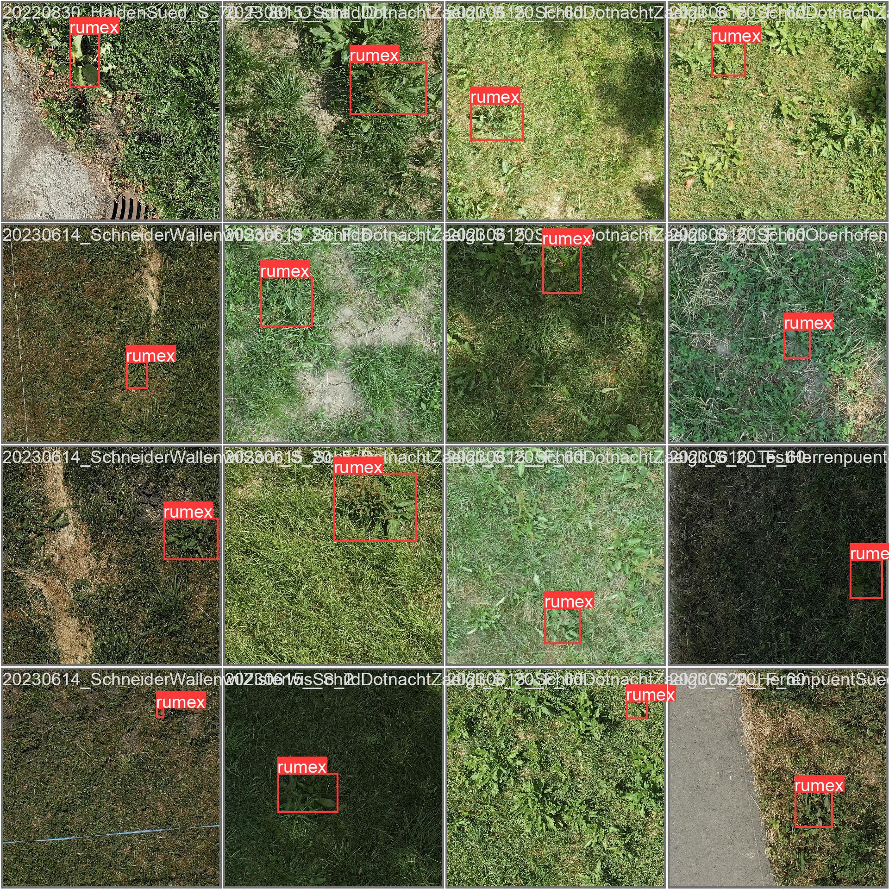
Yolo results

Slide 12
Bottom line
Generating synthetic data ⇒ Mix-match them with field in various conditions ⇒ more (and various) data for training.
Could be applied to other scenarios for weeds detection.

Slide 13
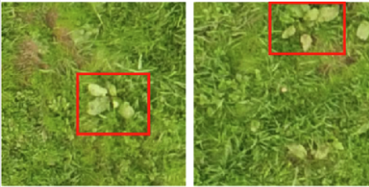
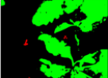
Datasets
(4x4)
(8x8)
bildacher
(4x4)
mix
bildacher
3800
600
200
500
backgrounds
8000
drone
6000

